Slide 1
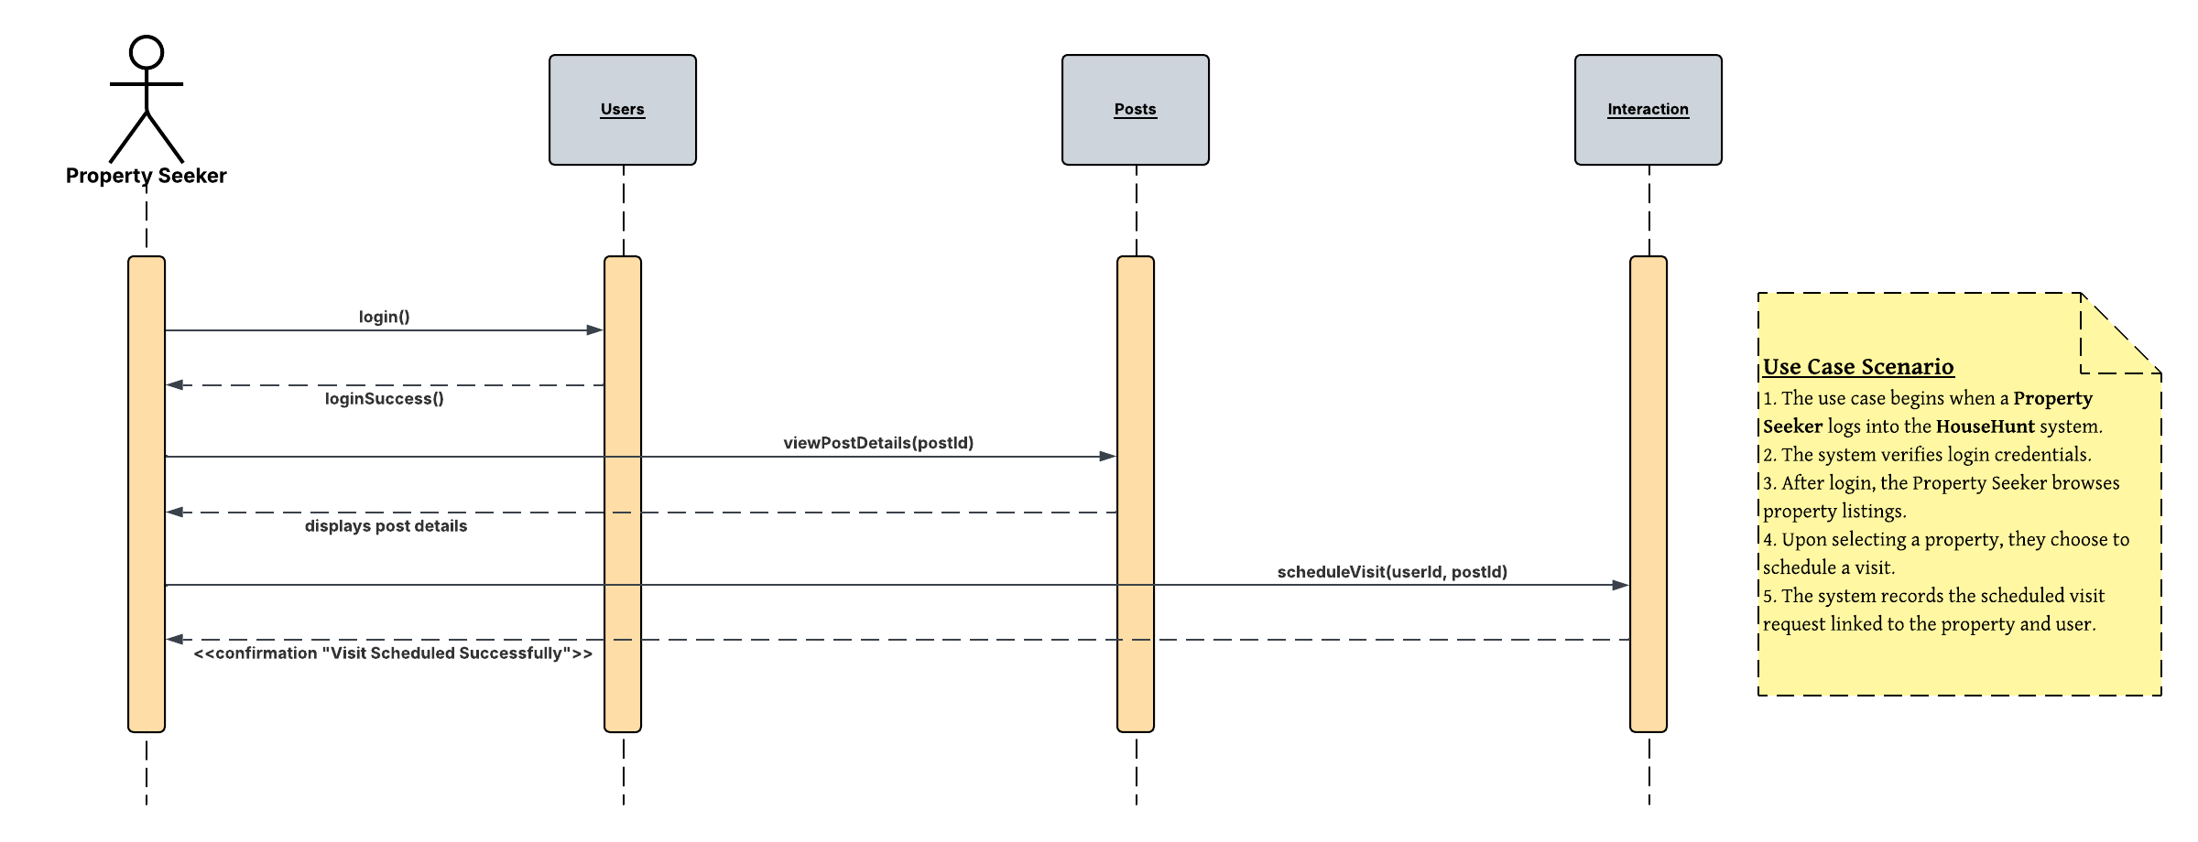
UML Sequence Diagram – House Hunt Use Case – 04.02 Schedule Property Visits

Slide 2

UML Sequence Diagram – House Hunt Use Case – 04.03 Property Inquiries

Slide 3

UML Sequence Diagram – House Hunt Use Case – 04.04 Reviews and Ratings for Properties and Sellers

Slide 4
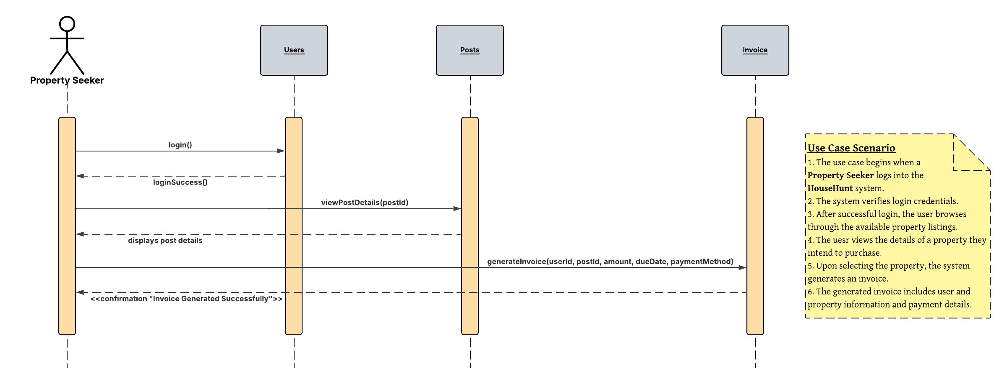
UML Sequence Diagram – House Hunt Use Case – 05.03 Invoice Generation

